Slide 1
Linear Models

Slide 2
Topics
Linear Regression
Cost Function
Normal Equation
Gradient Descent
Learning Rate
Gradient Estimation
Batch, Stochastic and Mini-batch Gradient Descent
Polynomial Regression Model
Learning curves
Bias-Variance Trade-off
Regularized models
Early Stopping
Logistic regression
Iris Dataset
Softmax Regression

Slide 3
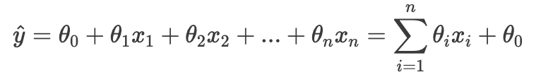
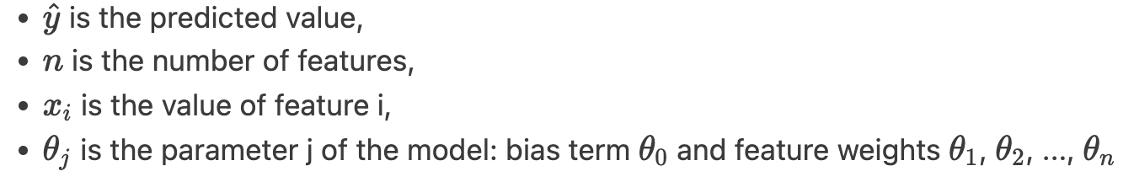
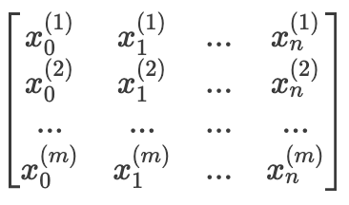
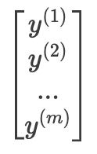
Linear Regression Model
It makes a prediction by simply computing a weighted sum of the input features, plus a constant called the bias term
Let's define the training set of m example as a matrix of m rows, in which each row is the i sample:

Slide 4
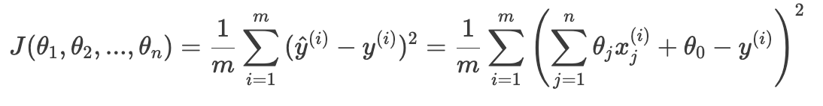
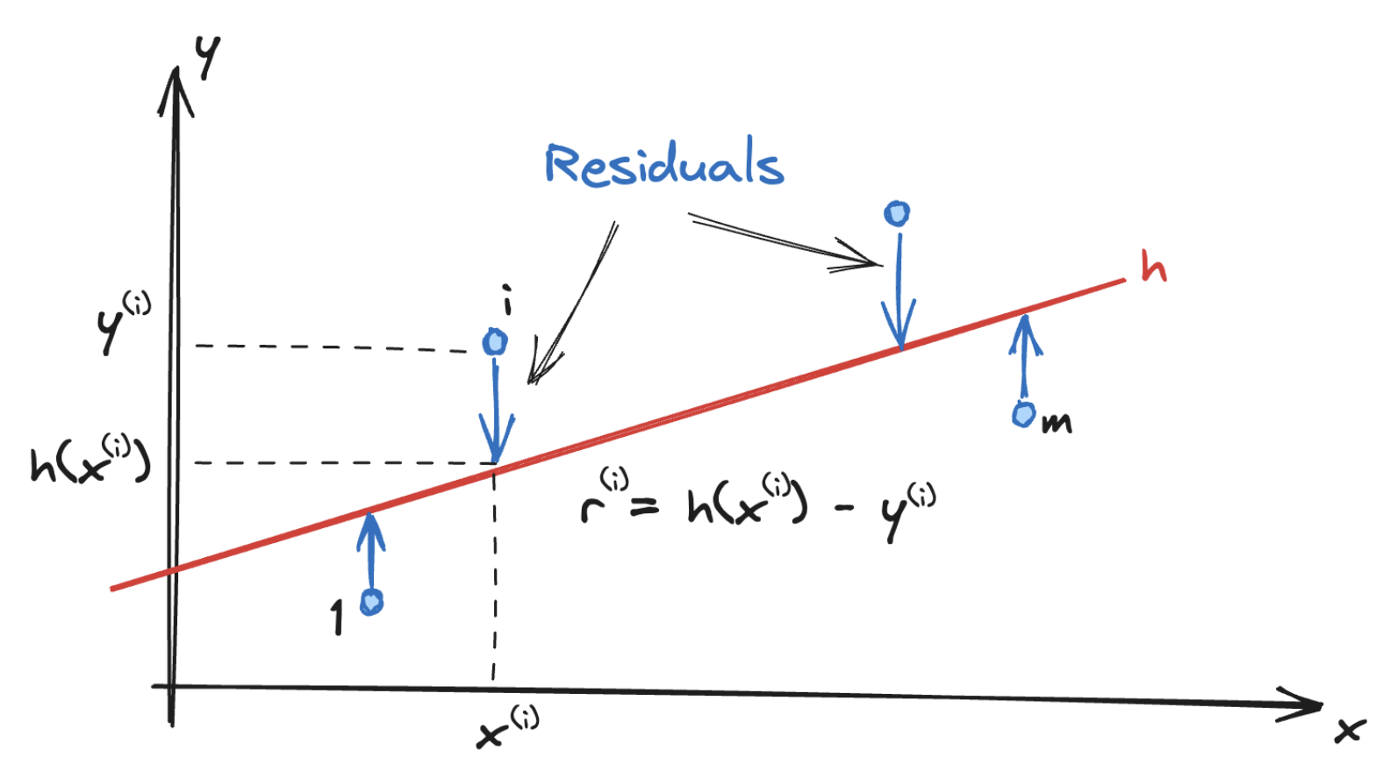
Cost Function (1)
A measure of how well the model fits the training data
In the linear case we use the Root Mean Square Error (RMSE) of the difference between the actual values of the training set and the predicted values (residuals)

Slide 5
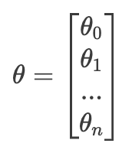
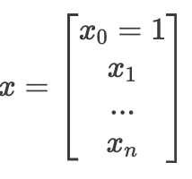

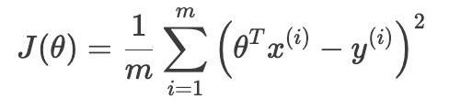
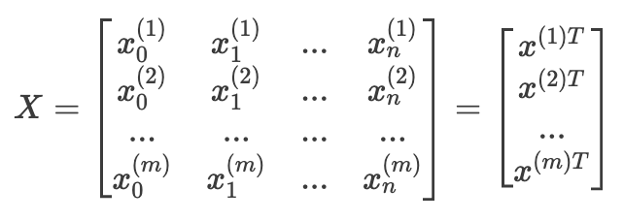
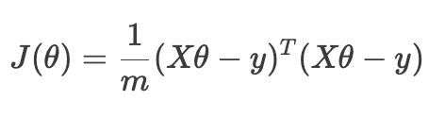
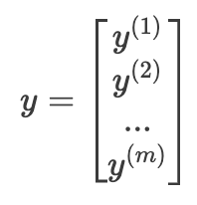
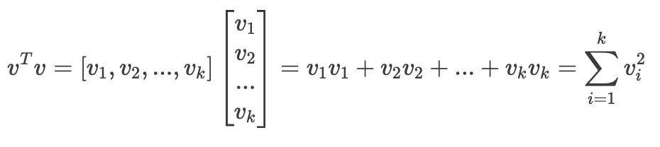
Cost Function (2)
This can be written much more concisely using a vectorized form and we can remove one of the summations in the cost function:
we can define also the training set in a matrix form and remove also the second summation:

Slide 6

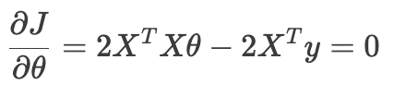



Normal Equation (1)
Cost function can be minimized using a closed-form solution:
Notice: 𝑋𝜃 and 𝑦 are vectors, when we multiply, it doesn't matter what order (if the dimensions work out):
To find where J has a minimum, we derive and compare to 0:
Assuming that the matrix 𝑋^{𝑇}𝑋 is invertible:
Where is s called pseudoinverse of X and expressed as X⁺
=>

Slide 7

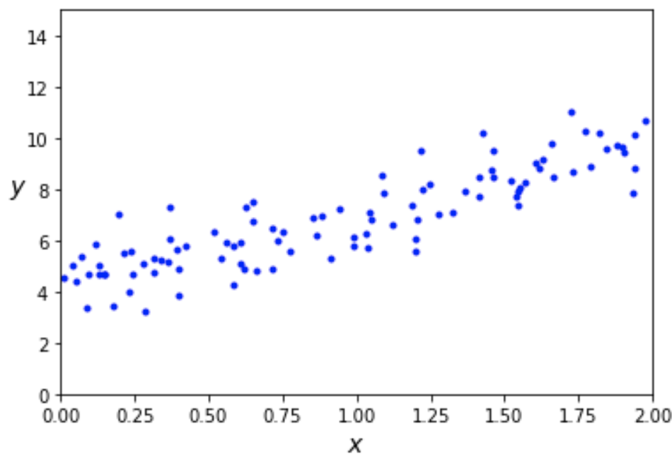
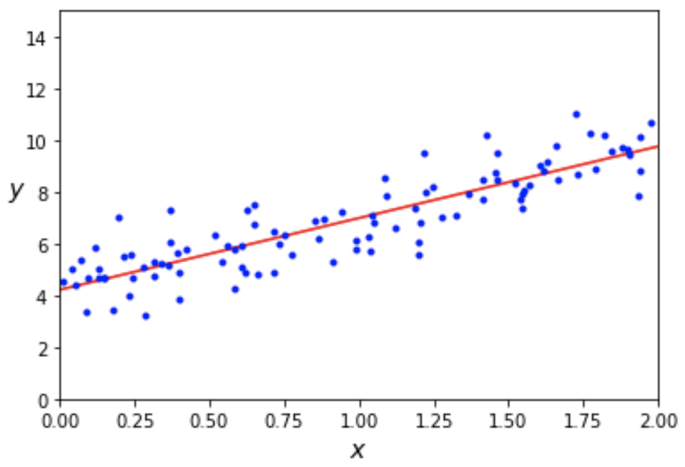

Normal Equation (2)
We can generate some linear-looking data
y = 4 + 3x + gaussian noise equation
Then we compute the best line using the Normal Equation
We obtain:
close enough to 4 and 3
noise made impossible to recover the exact parameters of the original function

Slide 8
Normal Equation (3)
The computational complexity of inverting such matrix is typically about O(n²) to O(n³)
depending on the implementation
gets very slow when the number of features grows large (e.g., 100,000)
However, the complexity is linear with the number of instances in the training set O(m)
handle large training sets efficiently
provided they can fit in memory
Predictions are very fast: the computational complexity is linear regarding both the number of instances and the number of features

Slide 9
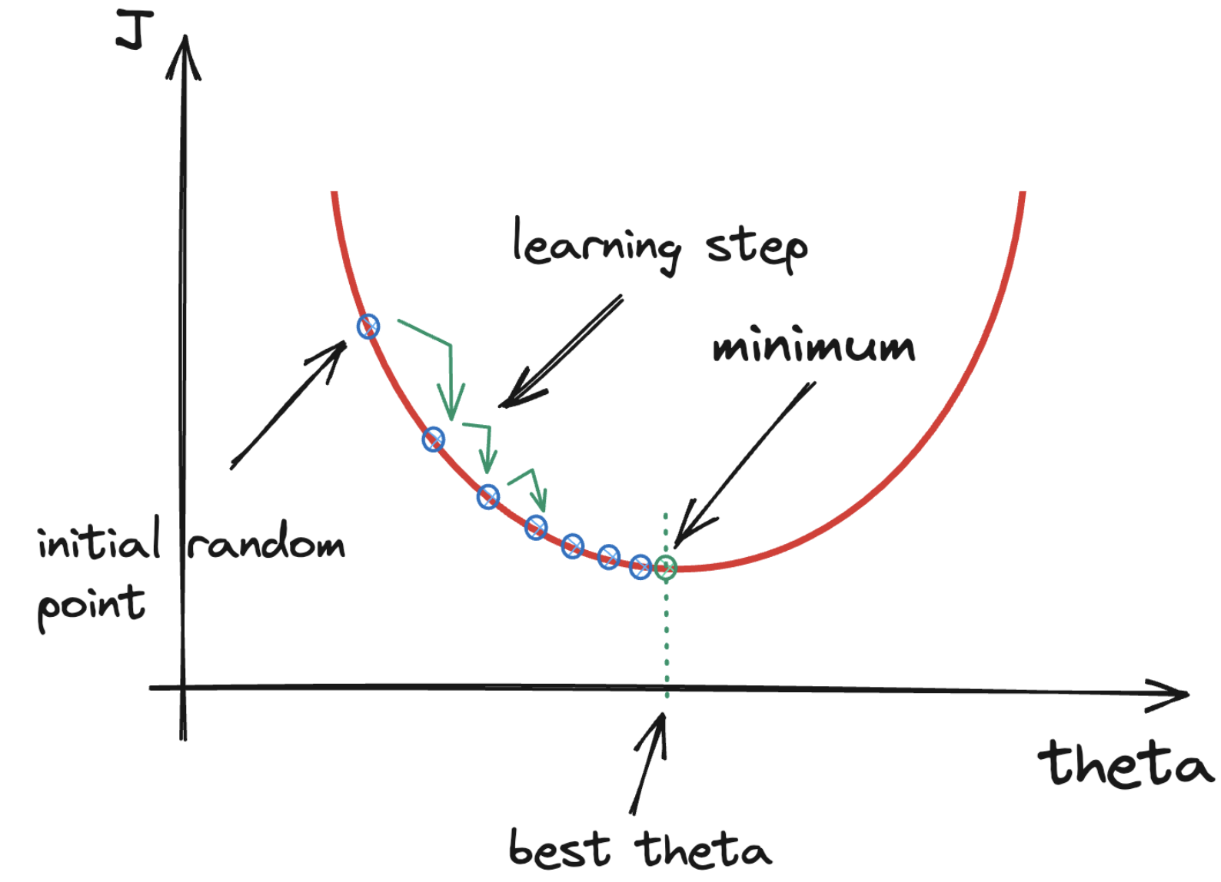
Gradient Descent (1)
A generic optimization algorithm
where there are many features
too many training instances to fit in memory
Main idea: the gradient (the vector of partial derivatives) gives the direction in which a function most quickly increases

Slide 10
Gradient Descent (2)
Algorithm:
pick a random starting point
fill 𝜃 with random values
compute the local gradient of J
take a small step in the opposite direction of the gradient
repeat with the new starting point
once the gradient is zero, we have reached a minimum!
The general idea is to tweak parameters iteratively to minimize the cost function

Slide 11
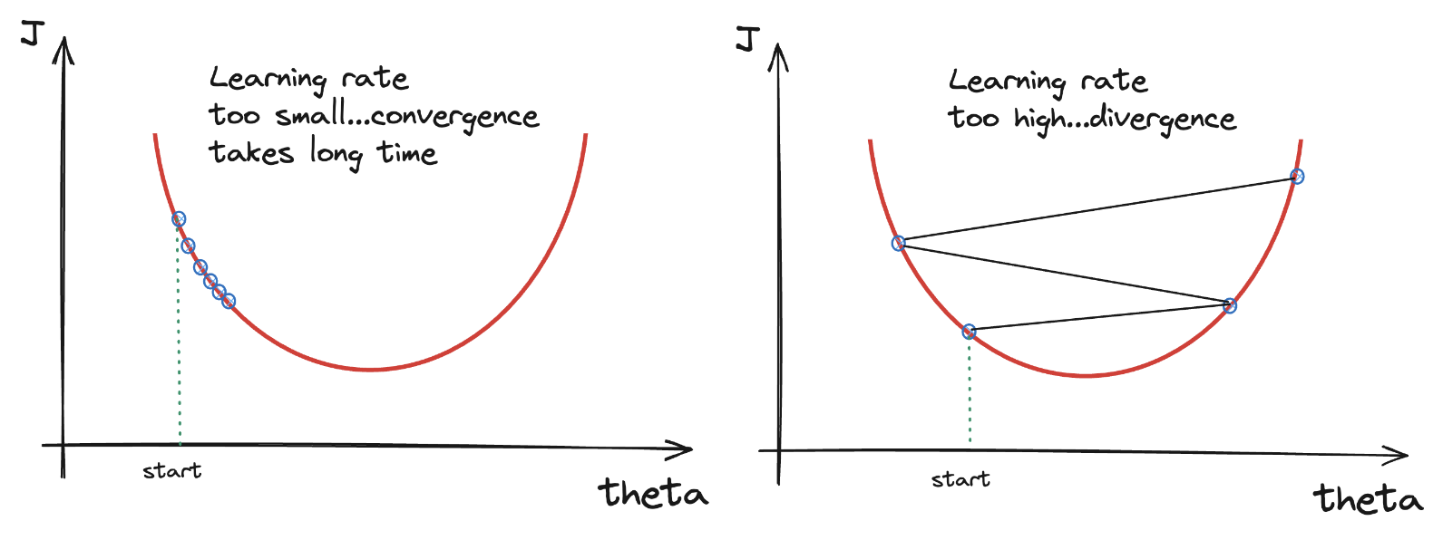
Learning rate
The size of the step
too small
algorithm will go through many iterations to converge, this takes a long time
too high
might jump across the valley and end up on the other side (even higher), it may diverge

Slide 12
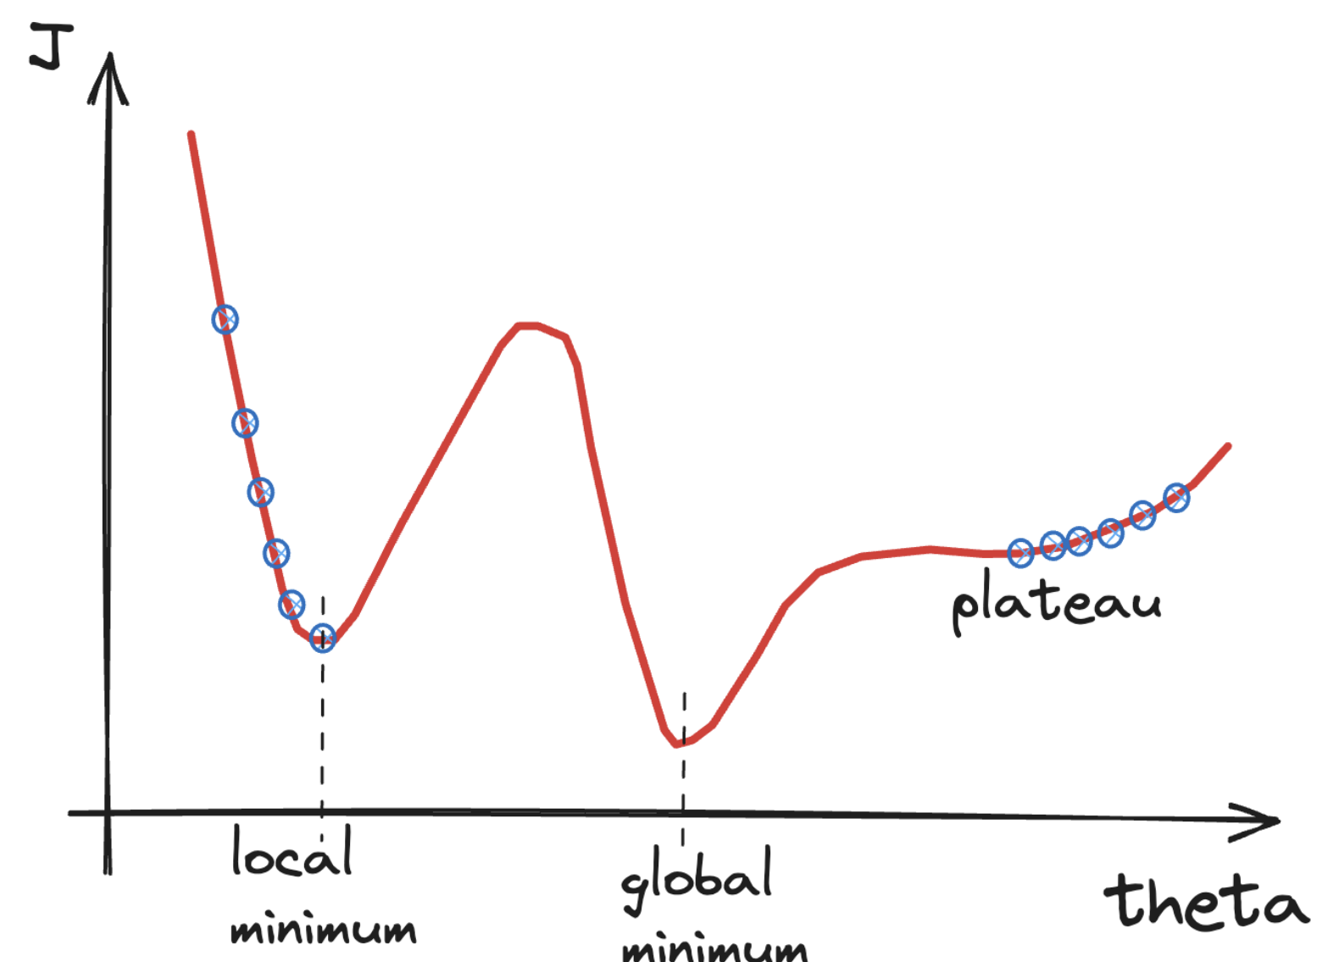
Global and local minimum
Not all cost functions have just one minimum
RMSE cost function of the linear model is convex
no local minima, just one global minimum
GD is guaranteed to approach arbitrarily close the global minimum (wait long enough)

Slide 13
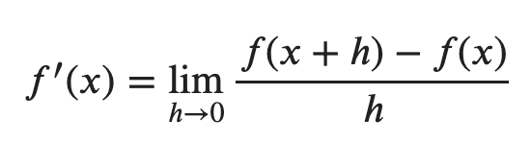
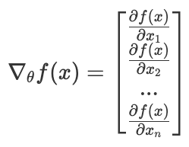

Gradient Estimation (1)
Derivative of a function of one variable is the limit of the difference quotients
When the function has many variables, it has multiple partial derivatives
each indicating how it changes when we make small changes in just one of the input
the gradient vector contains all the partial derivatives of the cost function
We can move towards the minimum, starting from a random point x, by subtracting the gradient using the learning rate factor:

Slide 14
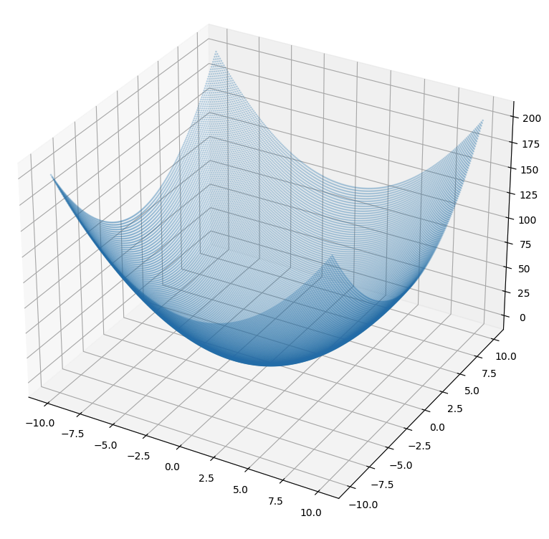
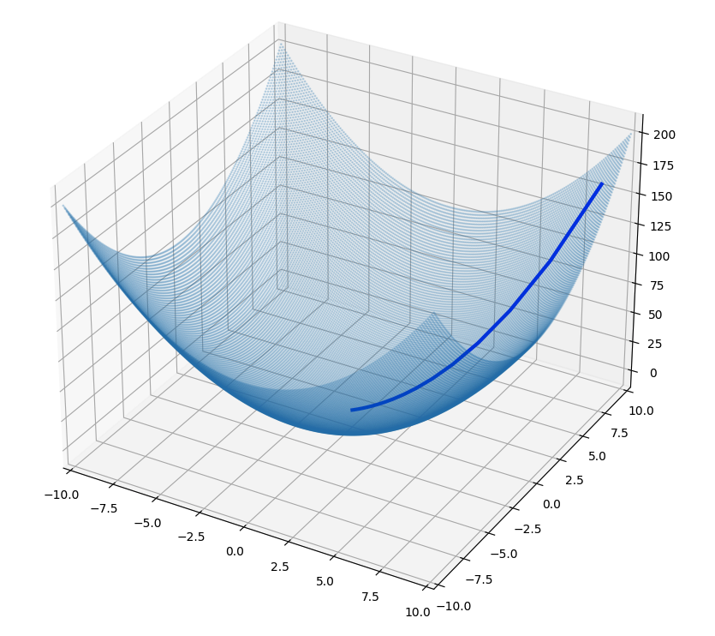
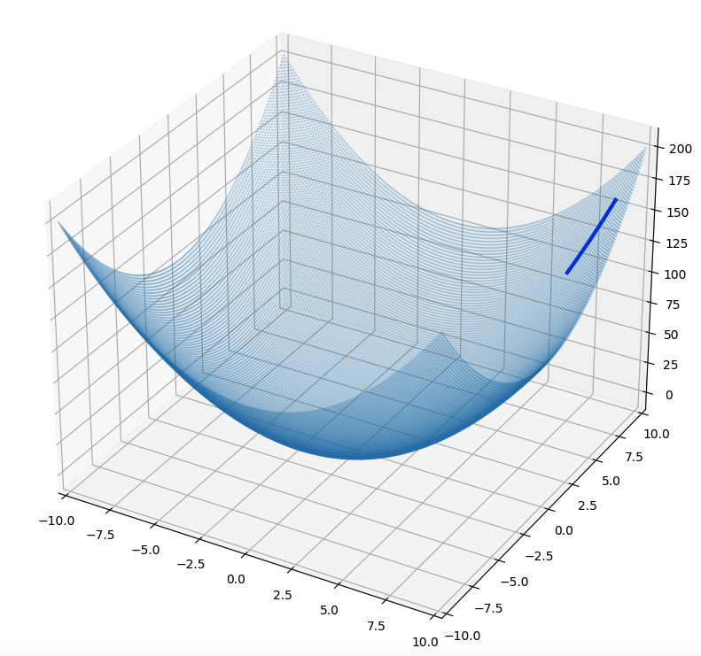
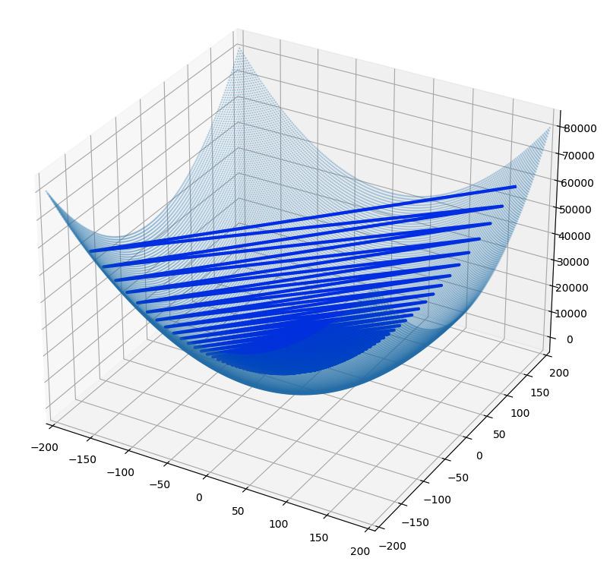
Gradient Estimation (2)
Consider a quadratic function of two variables
Let’s use gradients to find the minimum
pick a random starting point
take tiny steps in the opposite direction of the gradient
until we reach a point where the gradient is small
We can visualize the function and the path followed by GD to find the minimum.
learning_rate=0.1
learning_rate=0.001
learning_rate=1.015

Slide 15
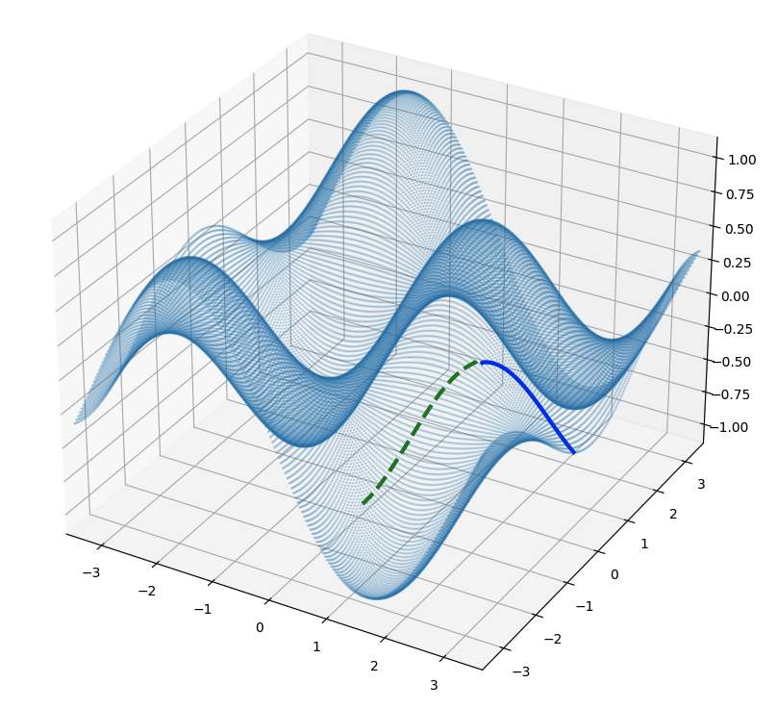
Gradient Estimation (3)
Consider a more complex function with several local minimum
GD finds different minimum values, depending on the starting point
the function is not convex
x_start_b = [1.5, 0]
x_start_a = [1.6, 0]

Slide 16
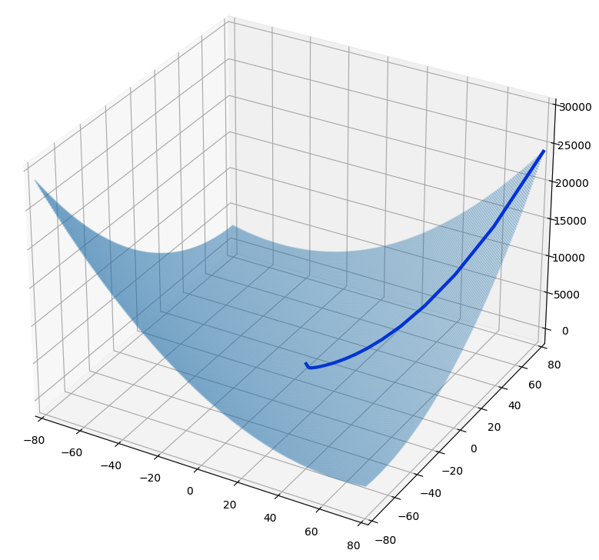
Batch Gradient Descent (BGD) (1)
We can apply the GD idea to fit the linear model
we need to compute the gradient of the cost function
notice: this involves calculations over the full training set at each step!

Slide 17
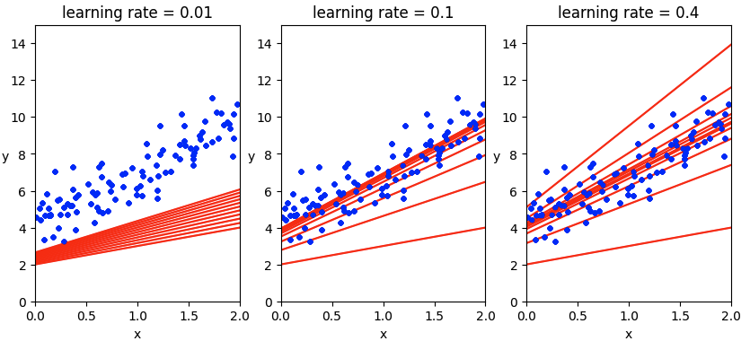
Batch Gradient Descent (BGD) (2)
But what if you had used a different learning rates?
To find a good learning rate: use grid search
To set the number of iterations: start with large number but interrupt when the gradient vector becomes tiny

Slide 18
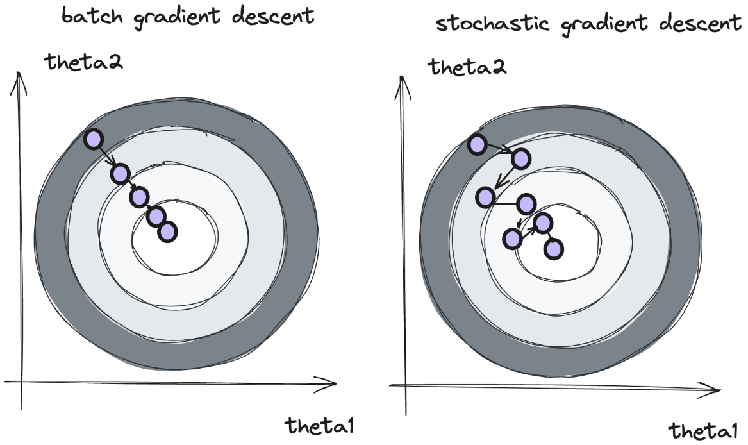
Stochastic Gradient Descent (SGD) (1)
BGD had to evaluate the gradients on the entire dataset before we could take a gradient step and update our parameters
example was fine, because dataset is "small" and gradient computation "cheap”
real models have large datasets and expensive gradient computations
Idea: computes the gradients based only on one single instance
much faster: it has very little data to manipulate at every iteration
works on huge training sets: only one instance needs to be in memory
The stochastic nature gives irregular behaviour
instead of gently decreasing towards the minimum, it will bounce up and down, decreasing only on average
when the cost function is very irregular, randomness can help jump out of local minima
however, once the algorithm stops, the final parameter values are good, but not optimal

Slide 19
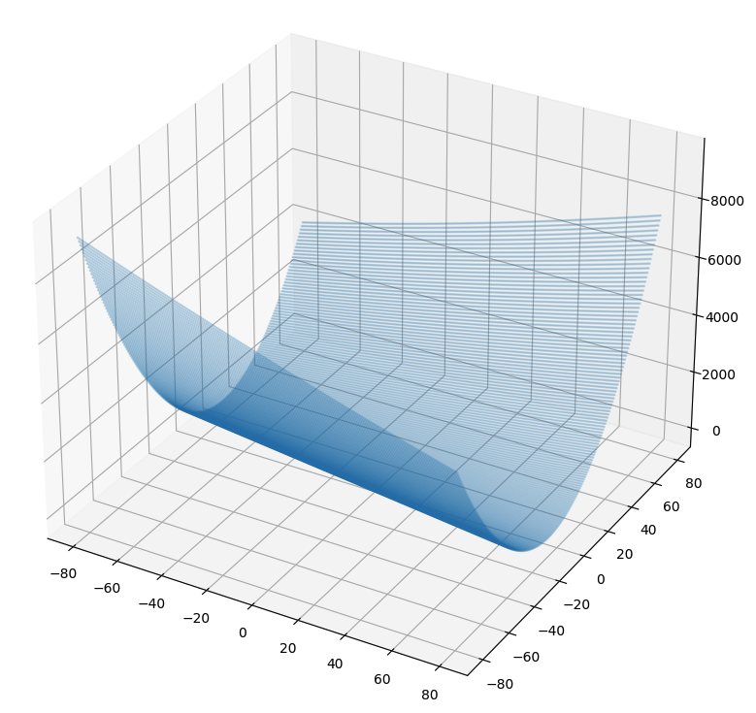
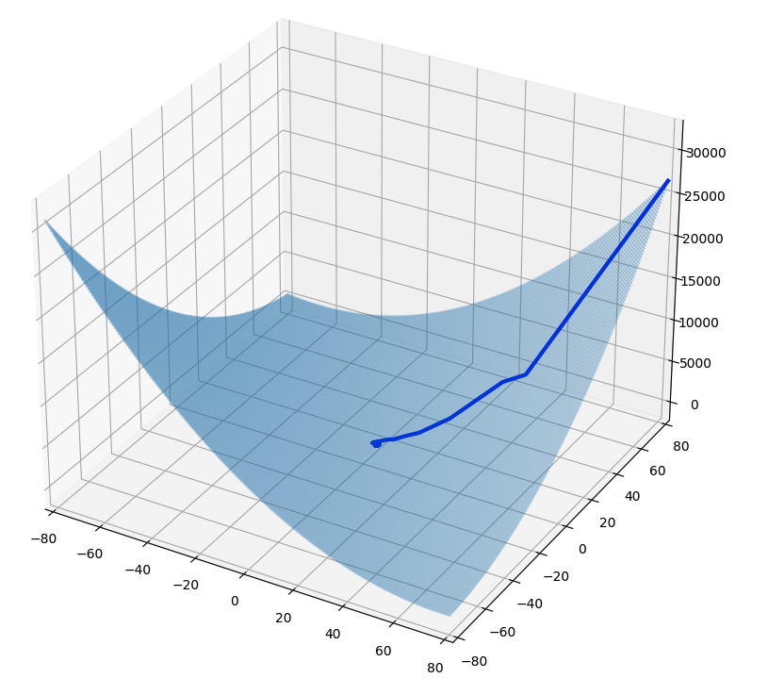
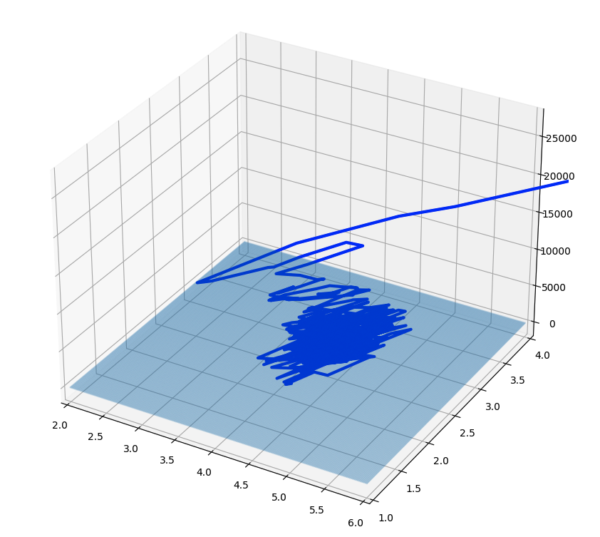
Stochastic Gradient Descent (SGD) (2)
We need to define the cost function, because we are now considering only one random instance at a time.
It is different at each step,, because it is based on a single instance
We can see that the path is less regular than the one followed by BGD. To better understand the differences, we can visualize the path near the minimum:
One solution to this dilemma is to gradually reduce the learning rate
step starts large, to escape local minima
then get smaller, to settle at the global minimum
learning schedule
We can implements SGD using a simple learning schedule
While the BGD code iterated 10,000 times through the whole training set, SGD code goes through the training set only 100 times and reaches a pretty good solution

Slide 20
Mini-batch Gradient Descent (MGD) (1)
We can use a compromise between BGD and SGD:
instead of computing the gradients based on the full training set (BGD)
or based on just one instance (SGD)
we can consider a small random sets of instances called mini-batches
The progress in parameter space is less erratic
especially with large mini-batches
MGD will end up walking around a bit closer to the minimum than SGD
it may be harder for it to escape from local minima
We can define:
training step: one iteration of the training process, where a subset of the training data (all in the case of the BGD, just one in the case of SGD or some instances for MBGD) is used to update the parameters
epoch: a complete pass through the entire training dataset. During one epoch, the model sees every example in the dataset and updates its parameters accordingly

Slide 21
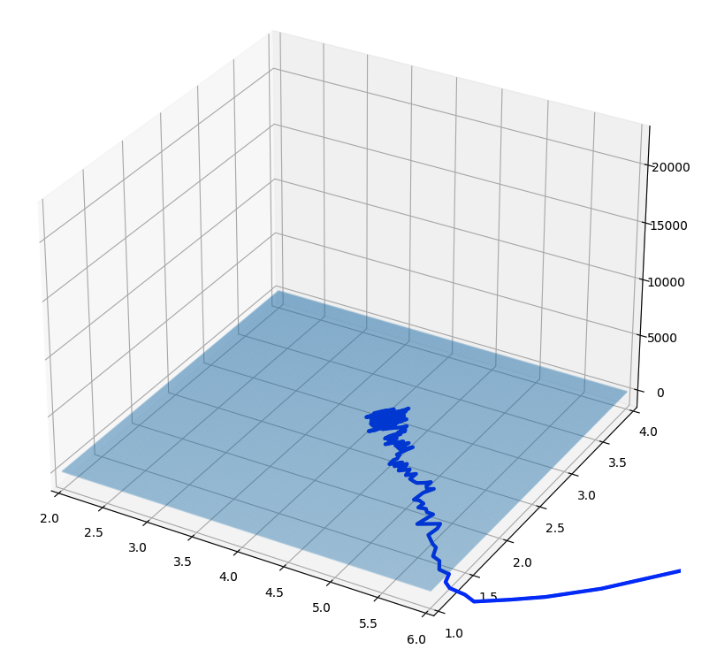
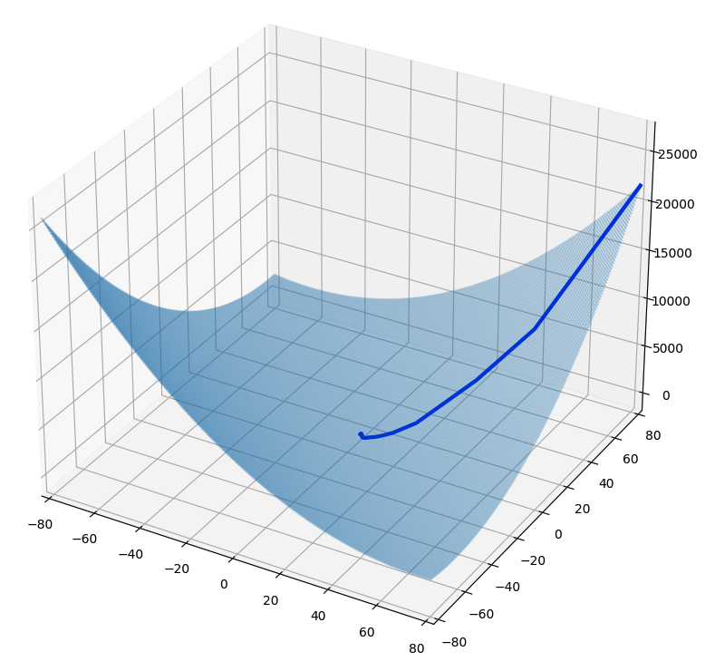
Mini-batch Gradient Descent (MGD) (2)

Slide 22
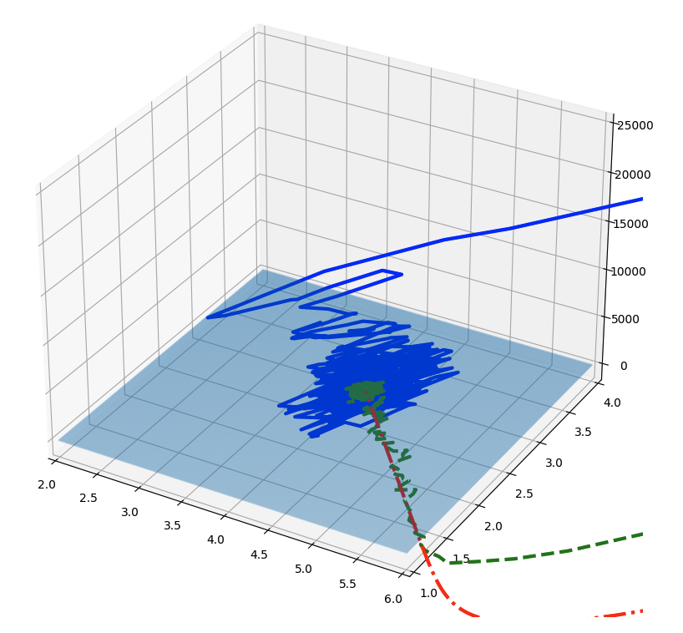
BGD, SGD, MGD Comparison
We can show the paths taken by the three algorithms in parameter space
All end up near the minimum
BGD path stops at the minimum
both SGD and MGD continue to walk around
BGD takes a lot of time to take each step
SGD and MGD would also reach the minimum using a good learning schedule

Slide 23
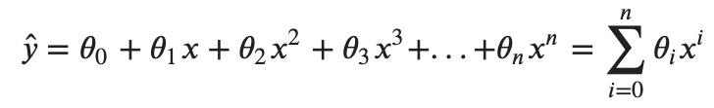
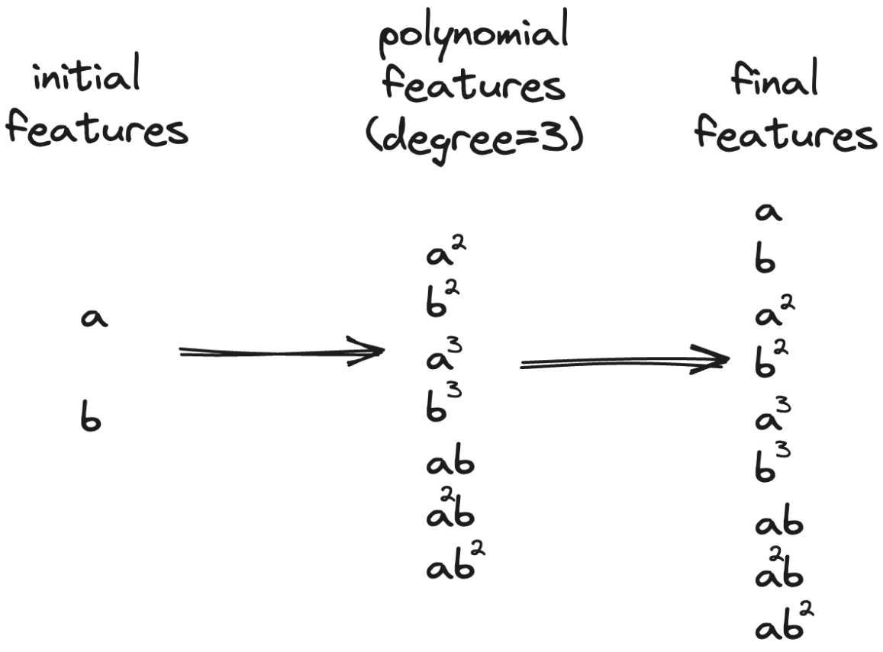
Polynomial Regression Model (1)
What if data are more complex than a straight line?
We can use a linear model also to fit nonlinear data
add powers of each feature as new features
then train a linear model on this extended set of features
For example, the relationship between the independent variable x and the dependent variable y is modelled as an n_{th} degree polynomial in x:
When there are multiple features, we can find relationships adding all combinations of features up to the given degree
Beware of the combinatorial explosion of features

Slide 24
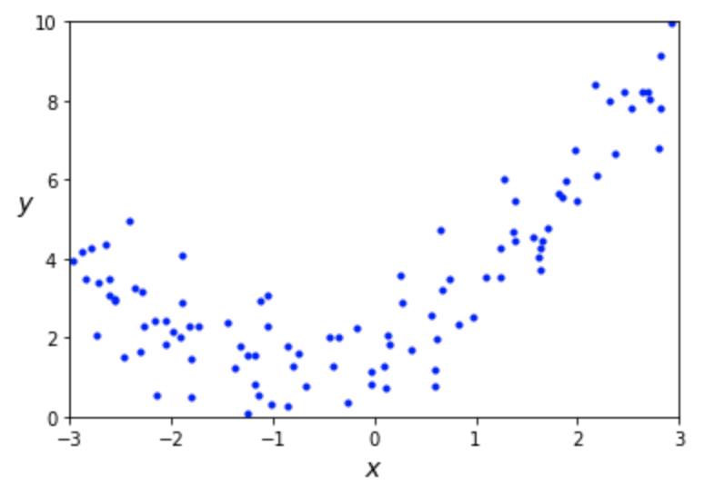
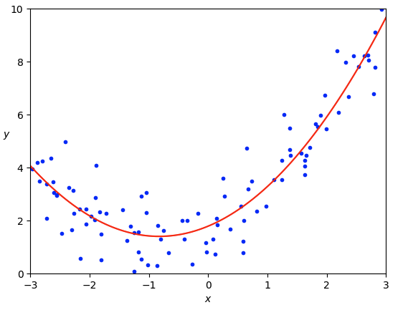
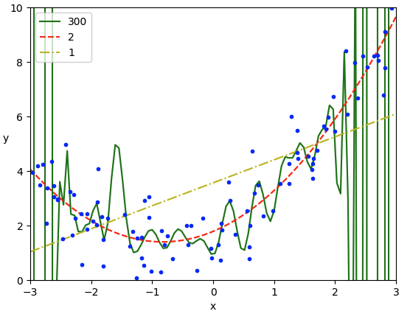
Polynomial Regression Model (2)
Consider a simple quadratic equation plus noise
Y = 0.5x² + x + random_noise
clearly, a straight line will never fit data
we can transform training data adding the square of each feature as a new feature
we can fit a linear model to this extended dataset
If we perform high-degree polynomial regression
we will likely fit the training data much better
however, the model is overfitting the training data
while the linear model is underfitting it
the model that will generalize best in this case is the quadratic model
How can we decide how complex the model should be?

Slide 25
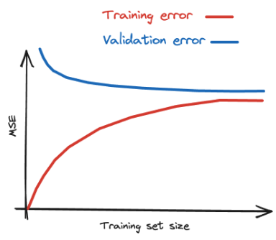
Learning curves (1)
Plot performance on training and validation sets as a function of the set size
On training data:
when there are just few instances the model can fit them perfectly
as new instances are added, it becomes difficult for the model to fit data
the error goes up until it reaches a plateau
On the validation data:
with few training instances, it is incapable of generalizing properly
as the model is shown more examples, it learns, and the error slowly goes down
error ends up at a plateau again

Slide 26
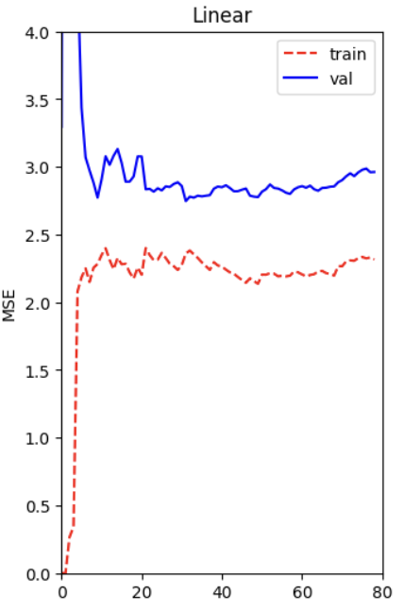
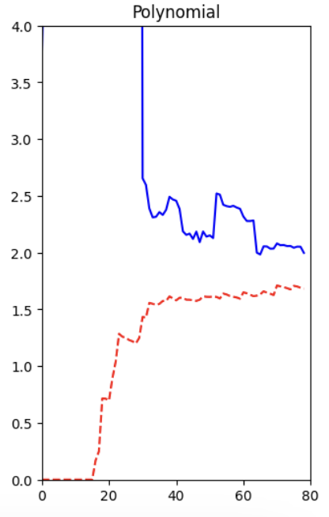
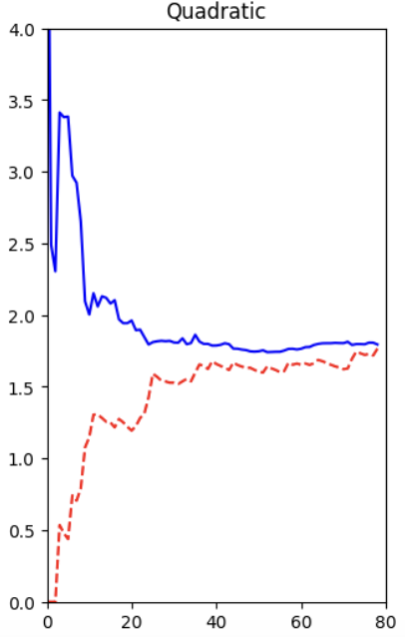
Learning curves (2)
Linear model
typical of an underfitting model
both curves have reached a plateau
they are close and fairly high
Polynomial model
typical of an ovefitting model
error on the training data is much lower
there is a gap between the curves
model performs significantly better on the training data than on the validation data: the hallmark of overfitting
Quadratic model
Typical of a model that generalize well
we don't have the gap
and the error is low

Slide 27
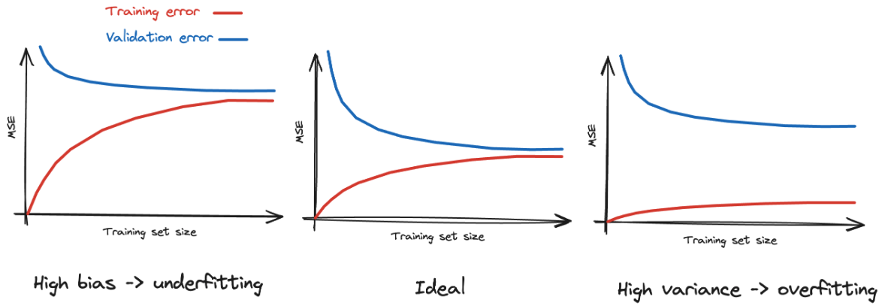
Bias-Variance Trade-off
The generalization error can be expressed as:
Bias: due to wrong assumptions
e.g. a linear model for quadratic data
high-bias model is most likely to underfit
Variance: due to model excessive sensitivity to small variations
models with high degrees of freedom
high variance model likely overfit
Irreducible error: due to the noisiness of the data itself

Slide 28
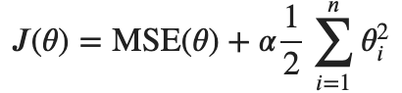
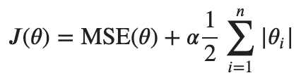
Regularized models (1)
A way to reduce overfitting is to constrain the model
the fewer degrees of freedom it has, the harder it will be for it to overfit the data
Ridge Regularization
adds a term to the cost function
penalty term is the sum of the absolute value of the magnitude of coefficients (L2 penalty)
force the algorithm to keep weights as small as possible
hyperparameter alpha controls how much we want to regularize
obtained coefficients can be used to identify most important features
Lasso Regularization
Least Absolute Shrinkage and Selection Operator Regularization
adds the norm of the weight vector
Lasso tends to eliminate the weights of the least important features
automatically performs feature selection

Slide 29
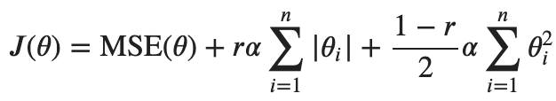
Regularized models (2)
Elastic Net
a middle ground between Ridge and Lasso
regularization term is a simple mix of both
controlled by the mix ratio 𝑟
When should we use plain Linear Regression, Ridge, Lasso, or Elastic Net?
it is almost always preferable to have at least a little bit of regularization
Ridge is a good default
If we suspect that only a few features are useful, we should prefer Lasso or Elastic Net
they tend to reduce the useless features’ weights down to zero
Lasso may behave erratically when
the number of features is greater than the number of training instances
when several features are strongly correlated
In general, Elastic Net is preferred over Lasso

Slide 30
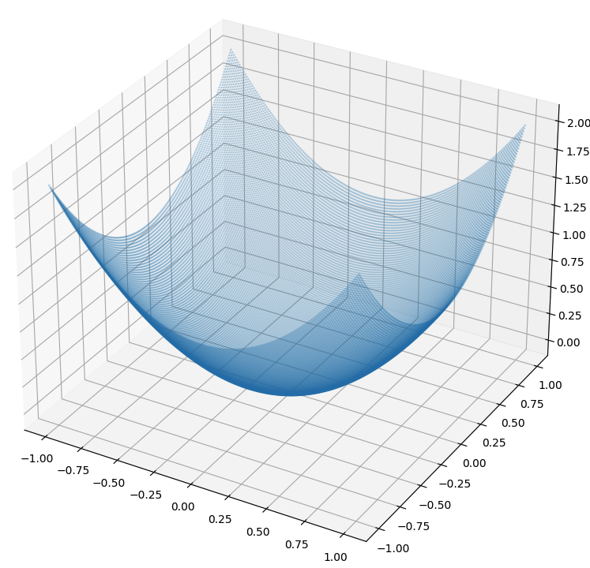
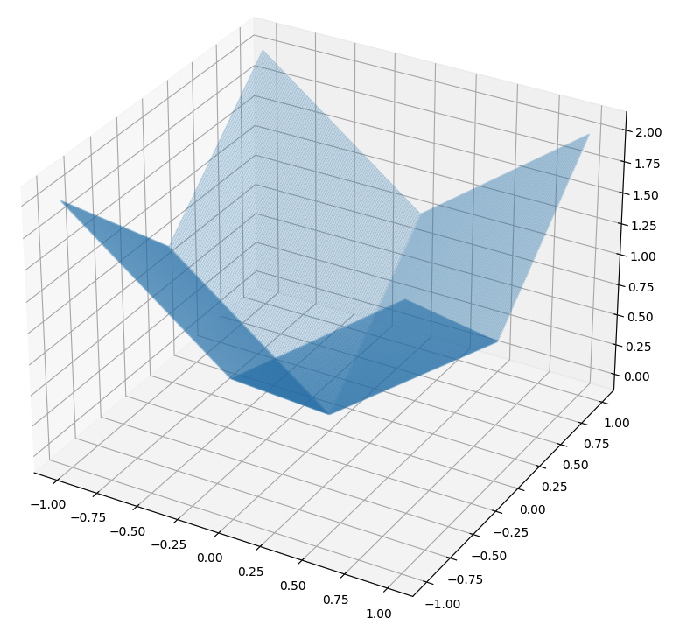




Regularized models (3)
To understand the influence on the cost function, we can consider only two features and plot the penalty term:
We can show the effect of regularization on a high-degree polynomial model using different value of alpha:
Ridge
Lasso
Elastic Net
Ridge
Lasso
Elastic Net

Slide 31

Early Stopping (1)
A way to regularize iterative learning algorithms: stop training as soon as the validation error reaches a minimum
Consider a complex model trained with BGD
as the epochs go, the prediction error on the training/validation sets goes down
after a while, the validation error stops decreasing and starts to go up
this indicates that the model has started to overfit the training data

Slide 32

Early Stopping (2)
We can try BGD on a high-degree Polynomial Regression model
after like 200 epochs, the validation error stops decreasing and starts to go back up.
we can stop the algorithm and the final model parameters are the ones that have the lowest validation error

Slide 33




Logistic Regression (1)
Some "regression" algorithms can be used for classification
estimate the probability that an instance belongs to a particular class
if the probability is greater than 50%, then the model predicts that the instance belongs to the “positive” class
otherwise, it predicts that it does not (it belongs to the “negative” class)
Logistic Regression model computes a weighted sum of the input features and outputs the logistic of this result:
Once the model has estimated the probability that the prediction is:

Slide 34



Logistic Regression (2)
The objective is to set the parameter vector so that the model estimates high probabilities for positive instances and low probabilities for negative instances:
Considering a single instance, this makes sense:
The cost J is convex function, so GD is guaranteed to find the global minimum

Slide 35


Iris Dataset (1)
Dataset containing the sepal and petal length and width of 150 iris flowers of three different species: Iris setosa, Iris versicolor, and Iris virginica.

Slide 36

Iris Dataset (2)
Consider a logistic regressor to detect Iris virginica based only on the petal width
petal width of virginica ranges 1.4-2.5 cm; other iris have a smaller width (0.1-1.8 cm)
there is a bit of overlap:
above 2cm and below 1cm the classifier is highly confident
in between the classifier is unsure
there is a decision boundary at around 1.6 cm

Slide 37

Iris Dataset (3)
We can use both features: petal width and length
dashed line represents the decision boundary

Slide 38




Softmax Regression (1)
We can generalize to support multiple classes directly
given an instance x
model computes a score s_{k} for each class k among K classed using the linear regression formula
then estimates the probability that the instance belongs to class k applying the softmax function to the score
classifier predicts the class with the highest estimated probability
As an example:
This classifier predicts only one class at a time
it is multiclass, not multioutput

Slide 39


Softmax Regression (2)
The objective is to have a model that estimates a high probability for the target class and consequently a low probability for the other classes
We can use as cost function the cross entropy:
with just two classes it is equivalent to the Logistic Regression cost function
The gradient vector of this cost function is given by
Now we can use BGD to find the parameter matrix that minimizes the cost function

Slide 40

Softmax Regression (3)
We ca use Softmax Regression to classify the iris flowers into all three classes

Slide 41
Exercise
Implement Batch Gradient Descent with Early Stopping for Softmax Regression, without using Scikit-Learn on the Iris dataset

